Slide 1
HIX Overview for Healthcare Technology Network of Greater Washington

Slide 2

The Onset of “Exchanges”
How did we get to this place?
PPACA
Health Cost Inflation
Public Exchanges
Affordability Concerns
Private Exchanges
Path to Defined Contribution
Commercial Sponsorship
Consumer-Directed Benefits
Health Insurance Exchanges
“Marketplace” Technology
“Retail” Expectations
Online Brokers
Consumerism
Copyright © 2013 Accenture All Rights Reserved. Accenture, its logo, and High Performance Delivered are trademarks of Accenture.
1

Slide 3
What is a HIX, or a HBE, or a SBE, or a FFE?
  HIX – Health Insurance Exchange
  HBE – Health Benefits Exchange
  SBE/SBM – State Based Exchange/ State Based Marketplace
  FFE/FFM – Federally Facilitated Exchange/ Federally Facilitated Marketplace
  All are flavors of a PPACA-mandated marketplace for individuals and small employers directly seeking to obtain health insurance.
Copyright © 2013 Accenture All Rights Reserved. Accenture, its logo, and High Performance Delivered are trademarks of Accenture.
2

Slide 4








Public Insurance Exchange at a Glance
Qualify & Fund
Or State Medicaid Agencies
Navigators*
Check Medicaid/SCHIP Eligibility and Enroll as Appropriate
Provide Oversight & Define Qualified Plan Guidelines
HHS
Educate & Promote Enrollment
Visit Portal to Shop for Plans
State Insurance Exchange
Transmit Enrollment
Contact Call Center for Inquiries / Assistance
Approve Health Plans
Individuals and
Small Groups
Payers
Render Care
Verify Citizenship / Immigrant Status
Determine Subsidies / Tax Credits
Transmit Subsidy
Providers
Administer Coverage Penalty
Submit Coverage Info
Process Premium Billing
Establish Provider Networks and Pay Claims
Copyright © 2013 Accenture All Rights Reserved. Accenture, its logo, and High Performance Delivered are trademarks of Accenture.
3

Slide 5
Must-Have Capabilities for States (and FFE)
Exchange Type | Functionality
General Exchange | Website Outreach and Education Customer Service and Account Management QHP Certification and Management Billing/Premium Collection (optional) Financial and Management Reporting Third Party Administration
Individual Exchange | Premium Subsidy Eligibility Individual Plan Comparison, Selection, and Enrollment Premium Tax Credit Subsidy Administration
Small Business Health Options (SHOP) | Employer Eligibility, Plan Selection and Contribution Strategy Employee Plan Comparison, Selection and Enrollment Employer Account Management
Copyright © 2013 Accenture All Rights Reserved. Accenture, its logo, and High Performance Delivered are trademarks of Accenture.

Slide 6
Who Can Purchase on the Exchange?
Exchange | Who can purchase on the exchange? | How will it work?
Individual | Must have legal immigration status Must reside within the sponsoring State Cannot be incarcerated | Individual chooses to be evaluated for subsidized healthcare coverage (or not) Exchange validates each person against the Federal Data Services Hub (FDSH)
SHOP | Employees of a registered and eligible employer Less than 50 “full time” employees Legitimate business tax ID | Employer Selects a benefit level (e.g., gold, silver, bronze) and a benchmark plan Indicates what contribution level they will pay toward their employee coverage and dependent coverage (separate decisions) Uploads a roster of eligible personnel Employee Logs into the SHOP portal to make their selections from among the choices made by the employer Purchases on the Exchange as individuals
Copyright © 2013 Accenture All Rights Reserved. Accenture, its logo, and High Performance Delivered are trademarks of Accenture.

Slide 7
An Inexperienced Consumer Group…
Most Public Health Insurance Exchange consumers are anticipated to be previously uninsured and / or inexperienced with health insurance products.
Previously insured in the Individual market
Pre-conceived expectations about how the system does / does not work
Likely has experience with one or more providers
May have experience navigating the system
4%
Previously insured with Medicaid
8%
Previously insured through Employer Sponsored Insurance
21%
67%
Largely uninformed
Likely has little to no experience in the health care system
Likely to need navigation support
Previously uninsured
Previously uninsured
Previously insured
Source: Kaiser Family Foundation “A Profile of Health Insurance Exchange Enrollees”, March 2011; “Uninsured but not yet informed” August 2011
Copyright © 2013 Accenture All Rights Reserved. Accenture, its logo, and High Performance Delivered are trademarks of Accenture.
6

Slide 8
What will these Consumers Buy?
  Levels of Coverage
 | Platinum – covers 90% of actuarial value of benefits
 | Gold – covers 80% of actuarial value of benefits
 | Silver – covers 70% of actuarial value of benefits
 | Bronze – covers 60% of actuarial value of benefits
! | Catastrophic – high-deductible plan for individuals up to age 30 or individuals exempted from the mandate to purchase coverage
States may choose add additional “voluntary” products, such as adult vision or long term care products, though this is unlikely for the initial wave of implementations.
Copyright © 2013 Accenture All Rights Reserved. Accenture, its logo, and High Performance Delivered are trademarks of Accenture.

Slide 9
Advanced Premium Tax Credits
Federal Poverty Level % (Absolute $ for Individual) |  | Maximum out of Pocket Expenditure
Up to 133% FPL ($14,856 individual) | 2% of income
133-150% FPL ($16,755 individual) | 3-4% of income
150-200% FPL ($22,340 individual) | 4-6.3% of income
200-250% FPL ($27,925 individual) | 6.3%-8.05% of income
250-300% FPL ($33,510 individual) | 8.05-9.5% of income
300-400% FPL ($44,680 individual) | 9.5% of income
Copyright © 2013 Accenture All Rights Reserved. Accenture, its logo, and High Performance Delivered are trademarks of Accenture.

Slide 10
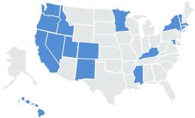
Types of Public Health Insurance Exchanges
State-based Exchange
Operate Exchange
Do Not Operate Exchange
Federally-Facilitated Exchange
Partner with HHS
Partnership Model
Feds perform Exchange eligibility, screen for Medicaid eligibility and refer to states for final determination
Feds handle core exchange functions such as plan shopping, enrollment, billing, plan management, etc.
States have the option to handle plan management and customer service
Managed Services Model
States “rent” MAGI (Modified Adjusted Gross Income) eligibility determination from the Feds
States handle core exchange functions such as plan shopping, enrollment, billing, plan management, etc.
Copyright © 2013 Accenture All Rights Reserved. Accenture, its logo, and High Performance Delivered are trademarks of Accenture.

Slide 11
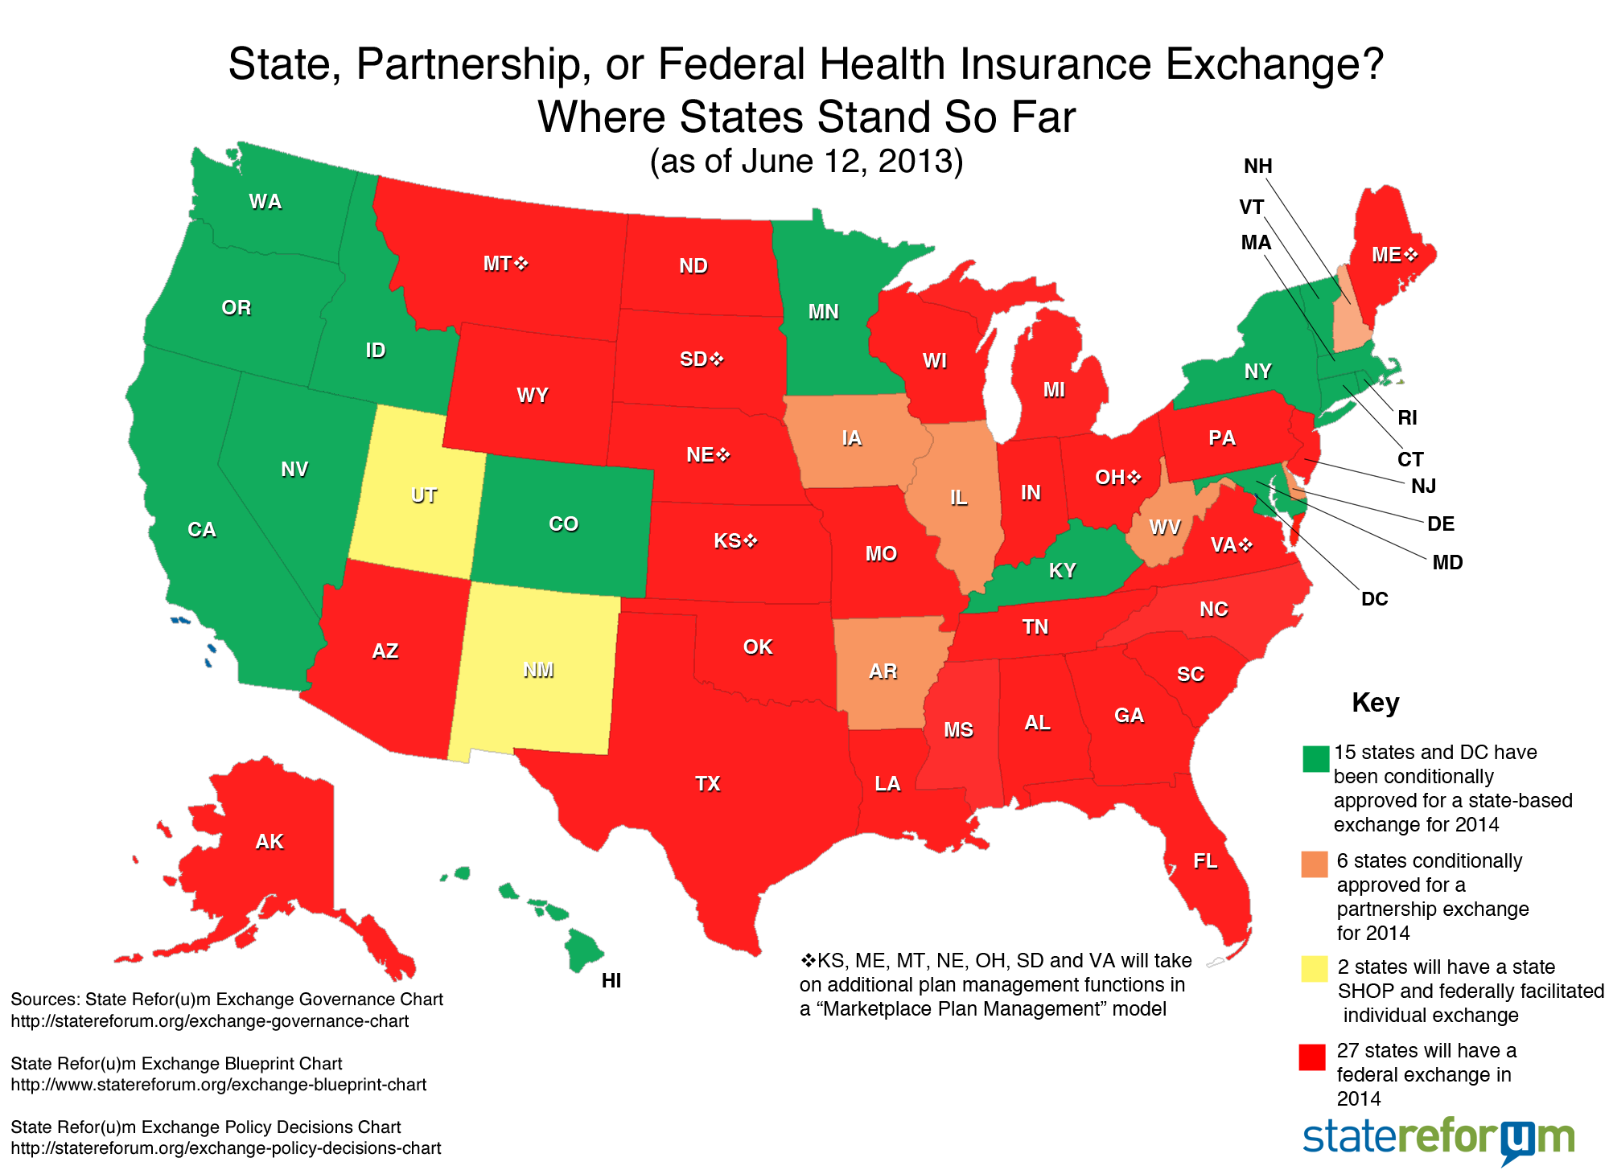
State Based Exchange Landscape
Notes:
Feds own the market
Not all greens and reds are equal
Statereforum is a great resource

Slide 12
State Based Exchange Key Policy Decisions
Market Organizer or Active Purchaser
Will the Exchange negotiate rates and benefits with carriers and drive a state health policy agenda via its contracting practices?
Premium Billing
State exchanges must manage premium billing for the SHOP exchange but have the option to ask payers to handle this function for Individual
Governance
“SBE” is not a homogenous term and there are different models states have chosen for governing the exchange
Medicaid Expansion
This decision will have material impact on the size of the SBE market and the financial sustainability of the exchange
Copyright © 2013 Accenture All Rights Reserved. Accenture, its logo, and High Performance Delivered are trademarks of Accenture.

Slide 13
Active Purchaser vs. Market Organizer
Legislation still being debated
Active Purchaser
Market Organizer
Active Market Organizer
Copyright © 2013 Accenture All Rights Reserved. Accenture, its logo, and High Performance Delivered are trademarks of Accenture.

Slide 14
Exchange Governance Structures
Legislation still being debated
State Agency
Quasi-public/Independent
Non-Profit
Copyright © 2013 Accenture All Rights Reserved. Accenture, its logo, and High Performance Delivered are trademarks of Accenture.

Slide 15
Medicaid Expansion Decision
Gov. Supports
Gov. Against
Undecided
Copyright © 2013 Accenture All Rights Reserved. Accenture, its logo, and High Performance Delivered are trademarks of Accenture.

Slide 16



Payer Key Considerations
Exchanges require a shift in mentality, in contrast to traditional healthcare operations, focused on the following considerations:
Technical and process efficiencies will be critically important given the variation in state exchange models and the widely held expectation that this business will yield thin margins relative to traditional health insurance segments
Development of “B-to-C” capabilities (e.g., consumer marketing, portals) will be critical as individual consumers and state exchange governing bodies are likely to demand retail-like experiences from its health insurers.
While health plans, especially Blues, have traditionally relied on strong brand presence to acquire and retain business, insurers will likely require a focused and local presence to build/maintain effective relationships with exchange governing bodies and win market share in each geography.
Nimble, efficient call centers that are effectively mapped to other call centers in the HIX ecosystem will be critical to success, as payers are likely to receive numerous inquiries that must be serviced by state or Federal exchange call centers.
Copyright © 2013 Accenture All Rights Reserved. Accenture, its logo, and High Performance Delivered are trademarks of Accenture.

Slide 17
Provider Considerations
Providers are likely to know more about the SBE consumer than payers or the state exchange itself—this insight and proximity is particularly valuable given the onset of community rating
Supply shortages create demand for physician extenders—pharmacy retail clinics, store-based clinics, NP-focused community health centers
Essential Community Provider requirements for QHPs elevate the profile of these provider types in both IDN and payer network strategies
Many SBE enrollees are likely to churn between SBE and Medicaid, creating challenges if benefits and provider networks are not aligned between Medicaid and the SBE
Navigation and assistance will be a fact of life for providers—those who do it well will be able minimize cost, increase efficiency and establish competitive brand positioning
Cost control is not on the SBE agenda now, but it will be
Copyright © 2013 Accenture All Rights Reserved. Accenture, its logo, and High Performance Delivered are trademarks of Accenture.

Slide 18





Risks and Issues
State Exchanges are in various states of readiness and are taking a number of approaches to achieving “success” by October 2013. Key Issues and risks include:
Delays in Federal and State readiness have greatly compressed the timeframe for Payers to be ready.
There is likely to be a window of dynamic change after October 2013, as SBEs refine their business models and FFE/Partnership states migrate from the Federal exchange to State-based exchanges.
Regulatory changes, such as product definitions, cost-sharing rules and subsidy tables, are likely to continue on an annual basis, in a manner similar to Medicare regulatory changes.
Managing risk will require advanced analytics (e.g., consumer segmentation), in lieu of traditional underwriting approaches, but will likely be challenging in early years of the exchanges.
Many health plans will look to migrate favorable risk toward private exchanges and non-subsidized products, an agenda strengthened by the ability to cross-sell ancillary and voluntary products.
Copyright © 2013 Accenture All Rights Reserved. Accenture, its logo, and High Performance Delivered are trademarks of Accenture.

Slide 19
Future Issues/Opportunities
SBE sustainability
  Adjacent and complementary services for revenue generation
  Affinity programs and preferred referral networks
  “Rent” HIX services to other states or parts of state government
Medicaid Bridge Plans
  SBE eligibles remain on family Medicaid MCO plans and draw down APTCs
  Medicaid funds used to cover premiums in the FFE for the Expansion population
Continuity of Care
  Lack of alignment in benefits and networks
Cost Control
  APTC impact on the Federal budget
Market failure and consolidation
Copyright © 2013 Accenture All Rights Reserved. Accenture, its logo, and High Performance Delivered are trademarks of Accenture.

Slide 20



Appendix 1: Private Exchanges
A private exchange is a marketplace to shop for employer-sponsored benefits…
What can I afford to spend? How much is my employer subsidizing?
What is the right plan for me given my unique healthcare needs and preferences?
What are my total expected out of pocket costs (e.g., fixed, likely)?
Interaction Channels
Marketplace
Breadth of Products & Choice
Education & Decision Support
Copyright © 2013 Accenture All Rights Reserved. Accenture, its logo, and High Performance Delivered are trademarks of Accenture.
19

Slide 21




Private Exchanges at a Glance
Private Exchange
Users
Front End
Back End Admin
Users
Channels
Consumer Marketplace
Eligibility & Enrollment
Individual
Shop & Enroll
Billing & Financial Management
Web/Portal
Manage Benefits
Marketing & Communications
Insurer Integration
Billing & Payment
Contribution
Employer / Broker Portals
Document Management & Fulfillment
Phone/IVR
Employer
Manage Eligibility/Records
Data Management
Oversee Billing / Payment
Mobile/Tablet
Reports & Compliance
Reporting
Contact Center
Decision Support
Sales
Service
Differentiated Product Library
Core Health
Other Insurance Products
Related Goods and Services
Key Capability
Copyright © 2013 Accenture All Rights Reserved. Accenture, its logo, and High Performance Delivered are trademarks of Accenture.
20

Slide 22














Private Exchange Solution Types
Two primary employer private exchange markets have emerged.
Model | 1. Retiree Exchange | 2. Active Exchange
Single Carrier Model Exchanges typically developed by payers (with large geographic footprint) to give members and employers access to their products
Multi Carrier Model Exchanges developed by payer consortiums, consultants, or producers to link consumers and employers to a variety of benefit plans across several payers in an “open” market
via
via
via
via
via
via
via
Note: Participant list is not exhaustive
21
Copyright © 2013 Accenture All Rights Reserved. Accenture, its logo, and High Performance Delivered are trademarks of Accenture.

Slide 23
Private Exchange Market Segments
Private exchange (PE) activity has been focused on post-65 retirees and small group, but continued growth is expected.
Employer Market | Employer Segment | Est. 2012 Lives Covered | 2012 PE Activity | 2015 Expected PE Activity | 2017 Expected PE Activity | Driving Factors
Retiree | Post-65¹ (Medicare) | 12 M | Less than 10% | 40 to 50% | 40 to 50% | Decline in retiree benefits Aging population Saturated PE market
 | Pre-65 (Early Retirees) | 8 M | Minimal | 10 to 20% | 20 to 30% | Increase in retirement age Decline in retiree benefits Underwriting changes Potential to move to public Exchange
Active | Jumbo (10,000+) | 45 M | Minimal | Less than 10% | 10 to 20% | Pressures to maintain coverage (mandate, penalties, social) Potential for certain groups (e.g., retail) to convert group to individual products
 | Large (2,500 – 9,999) | 20 M | Minimal | Less than 10% | 20 to 25%
 | Mid-Large (500 – 2,499) | 20 M | Minimal | Less than 10% | 25 to 30% | Shift from defined benefit plans to defined contribution
 | Small-Mid (100 – 499) | 25 M | Less than 10% | 10 to 20% | 30 to 40%
 | Small (< 100) | 60 M | Less than 10% | 30 to 40% | 40 to 50% | State Exchanges Decision to move to state Exchange, drop coverage, maintain, or move to PE
Source: U.S. Census, Bureau of Labor and Statistics, Kaiser Employer Health Benefits 2012 Annual Survey, Accenture Research. Calculations assume 2.4 covered lives per employee receiving group benefits.
Copyright © 2013 Accenture All Rights Reserved. Accenture, its logo, and High Performance Delivered are trademarks of Accenture.
22

Slide 24
Differentiating Private Exchange Capabilities
The Group Active and Retiree exchanges have unique capability differentiators, driven by marketplace expectations.
Active Employees | Retirees
Ease of loading products Online shopping and decision support List billing and payroll integration End-to-end workflow Ability to support non-health products | Licensed agents to support annual enrollment CRM technology for call scheduling and tracking Split billing and payments Reconciliation and delinquency management CMS regulatory compliance
Copyright © 2013 Accenture All Rights Reserved. Accenture, its logo, and High Performance Delivered are trademarks of Accenture.
23

